Slide 1
Functions & loops in r
EFGH Data Core
In-person orientation, Nairobi
Olivia Schultes
Aug 19, 2025

Slide 2
Dry Coding principle: “don’t repeat yourself”

Slide 3
Why should I utilize tools to automate iterative functions?
Purpose: perform the same data manipulation iteratively
Advantages
Efficiency (fewer lines of code)
Reduces likelihood of copying mistakes
Easier to update
Applications
Calculating a new variable
Performing the same analysis across a set of predictor variables
Producing figures by different subsets of data
And so much more…

Slide 4
Topics Covered today
For-loops
Functions
Map
Apply family
(If time)
(If time)

Slide 5

For-loops

Slide 6
structure
for (value in sequence) {
statement
}
2 inputs: value and sequence
Sequence is vector of terms you’d like the operation to be applied to
Value is a stand-in for each value in the sequence
Statement describes the data manipulation applied to each value in sequence

Slide 7
basics
for (x in 1:10) {
print(x)
}
> [1] 1
> [1] 2
> [1] 3
> [1] 4
> [1] 5
…
vec <- NULL
seq <- 1:10
for (i in seq) {
vec[i] <- i
}
print(vec)
> [1] 1 2 3 4 5 6 7 8 9 10
Notes:
In the first example, we’re asking the for-loop to consecutively print the numbers 1 through 10. In the second example, we’re creating a new object vec, which is empty. Then inside the for-loop, we assign a value to each index of vec indicated by the I within the square brackets. Finally, we print the object vec outside the for-loop.

Slide 8
basics
for (x in 1:10) {
print(x)
}
> [1] 1
> [1] 2
> [1] 3
> [1] 4
> [1] 5
…
vec <- NULL
seq <- 1:10
for (i in seq) {
vec[i] <- i
}
print(vec)
> [1] 1 2 3 4 5 6 7 8 9 10
Can use different letters for value
Notes:
Note that we can use different letters for the value

Slide 9
basics
for (x in 1:10) {
print(x)
}
> [1] 1
> [1] 2
> [1] 3
> [1] 4
> [1] 5
…
vec <- NULL
seq <- 1:10
for (i in seq) {
vec[i] <- i
}
print(vec)
> [1] 1 2 3 4 5 6 7 8 9 10
Can specify sequence outside of or within for loop
Notes:
Also note that we can specify the sequence outside or within the loop. In the second example, we specify the object “seq” as 1 through 10 and then reference seq inside the for-loop

Slide 10
basics
for (x in 1:10) {
print(x)
}
> [1] 1
> [1] 2
> [1] 3
> [1] 4
> [1] 5
…
vec <- NULL
seq <- 1:10
for (i in seq) {
vec[i] <- i
}
print(vec)
> [1] 1 2 3 4 5 6 7 8 9 10
New object containing values from sequence: vec
No new object created!
Notes:
The 1st example is classically used when introducing for loops
However, this is not very helpful; usually, we are trying to create something new with for loops, and here we don’t have a new object we can use. We just have the series of numbers printed as sequentially as separate objects.
Let’s look at the 2nd example instead
First we specify an empty object vec
Then in the statement, we assign the current value of I to each ith index of vec
So the first time we run through the loop, the first index of vec is assigned a value of 1, the second time the second index is assigned to 2, etc.
At the end we have changed the value of vec and now have an object in our global environment that we can work with (do things like print)

Slide 11
global vs execution environments
What happens if we don’t create vec before the for-loop?
We can’t assign values to an index of an object that doesn’t exist
Returns an error
# vec <- NULL
seq <- 1:10
for (i in seq) {
vec[i] <- i
}
Error: object ‘vec’ not found
Notes:
In this example, we try to run the second version of the for-loop without specifying vec beforehand. This gives us an error that the object ‘vec’ was not found

Slide 12
global vs execution environments
seq <- 1:10
for (i in seq) {
vec <- vec
vec[i] <- i
}
Error: object ‘vec’ not found
seq <- 1:10
for (i in seq) {
vec <- 0
vec[i] <- i
}
print(vec)
> [1] 0 NA NA NA NA NA NA NA NA 10
vec still never created
vec created within the function
Each time the function loops around a new index is added, but the value of the first index is returned to 0
Only the value assigned to the last index (10) is retained
Notes:
Let’s try two other ways. Next, on the left, we’ll try assigning vec as vec, but vec was still never created in the first place so this still gives us the same error.
After that on the right, we tried assigning vec as 0 within the for-loop. Now the for-loop will run, but what happened? We got a string with 0, 8 NAs, and 10. this is because each time the function of the loop is preserved. In this case, it is 0 in the first index and then 10 in the 10th index because on the last iteration, vec is reassigned to just 0, erasing the prior values added to it, and then the 10th index is assigned a value of 10. Since indices 2-9 weren’t specified on the last iteration of the for-loop, these are assigned NA values.

Slide 13
global vs execution environments
vec <- NULL
seq <- 1:10
for (i in seq) {
vec[i] <- i
}
print(vec)
> [1] 1 2 3 4 5 6 7 8 9 10
seq <- 1:10
for (i in seq) {
vec <- 0
vec[i] <- i
}
print(vec)
> [1] 0 NA NA NA NA NA NA NA NA 10
Created in the global environment
Created in the execution environment
Notes:
The difference between this example and the original example is that in the original example vec was specified in the global environment, and in the follow-up example vec was created in the execution environment.
Within a for-loop, an execution environment is created. It is ephemeral and will disappear once the for-loop is completed
Objects created within that environment will be re-created each time the loop is run, which is what we saw in the last example
Often, it is a better option to create an empty object (vector/data frame/list) in the global environment and simply manipulate or modify it within the for-loop

Slide 14
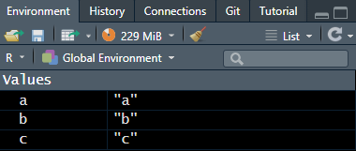
global vs execution environments
Global environment
Exists continuously across a single R session. Contains objects and functions that are assigned names.
Example: when reading a file into an R session, they become a part of the global environment
Execution environment
Only exists while a for-loop or function is running. May contain arguments or objects that are not assigned values or names and are therefore not created in the global environment. Objects assigned a name & value in execution environment will appear in global environment.
Example: for-loop printing numbers 1 through 10 will not produce new object in global environment
Note: for methods of checking what is contained in an execution environment, see chapter 7.4.4 of Advanced R by Hadley Wickham
Notes:
To summarize, the global environment contains objects that are created and assigned a name and value during a coding session in R. An example of this is when files are read into R – these files are assigned to objects in the global environment. To check what is in the global environment, you can check the “Environment” tab of your Rstudio panel.
The execution environment, in contrast, contains objects and arguments called or created within a function or for-loop. Objects that are assigned a name and value in the execution environment will appear in the global environment, as was the case with vec in the last example. Note that this environment is ephemeral and only exists while the for-loop or function is running; in order to check what is contained in the execution environment, we need advanced tools (see Advanced R chapter 7.4.4).

Slide 15
Example 1: reading in files
rds_list <- list.files(path = , pattern = "*.Rds", full.names = TRUE)
name_list <- sub("./", "", rds_list)
name_list <- sub(".Rds", "", name_list)
for (i in 1:length(rds_list)) {
assign(name_list[i], readRDS(rds_list[i]))
}
Notes:
Let’s look at an example now. Here, we are going to read in all the files ending in .Rds in our working directory, which should be the folder where the accompanying script was downloaded to. May need to use following code: setwd("./../../2025_kenya_iteration")

Slide 16
Example 1: reading in files
rds_list <- list.files(path = , pattern = "*.Rds", full.names = TRUE)
name_list <- sub("./", "", rds_list)
name_list <- sub(".Rds", "", name_list)
for (i in 1:length(rds_list)) {
assign(name_list[i], readRDS(rds_list[i]))
}
Key function:
list.files – create character vector with files in a certain folder
Notes:
First, we’ll create a vector that contains the full names of all the files ending with .Rds using the function list.files()

Slide 17
Example 1: reading in files
rds_list <- list.files(path = , pattern = "*.Rds", full.names = TRUE)
name_list <- sub("./", "", rds_list)
name_list <- sub(".Rds", "", name_list)
for (i in 1:length(rds_list)) {
assign(name_list[i], readRDS(rds_list[i]))
}
Notes:
Next, we’ll create another vector with some of the extra text trimmed off of the file names. This will give us cleaner names to assign to the objects in R and will make coding easier

Slide 18
Example 1: reading in files
rds_list <- list.files(path = , pattern = "*.Rds", full.names = TRUE)
name_list <- sub("./", "", rds_list)
name_list <- sub(".Rds", "", name_list)
for (i in 1:length(rds_list)) {
assign(name_list[i], readRDS(rds_list[i]))
}
head(rds_list)
> [1] "./scrambled_data.Rds" "./scrambled_medication.Rds" "./scrambled_preenrollment.Rds"
head(name_list)
> [1] “scrambled_data" “scrambled_medication" “scrambled_preenrollment"
Notes:
Now if we look at rds_list and name_list, we have 2 vectors of the same length with the names of file pathways and desired object names in the same order

Slide 19
Example 1: reading in files
rds_list <- list.files(path = , pattern = "*.Rds", full.names = TRUE)
name_list <- sub("./", "", rds_list)
name_list <- sub(".Rds", "", name_list)
for (i in 1:length(rds_list)) {
assign(name_list[i], readRDS(rds_list[i]))
}
Key function:
assign – assign a value to a name in an environment
Notes:
Finally, we’ll use the assign function within a for-loop. For every object in the vector rds_list, we’ll assign the name as that index of the name list and read in the file using the same index from the file list.

Slide 20
Example 1: reading in files
rds_list <- list.files(path = , pattern = "*.Rds", full.names = TRUE)
name_list <- sub("./", "", rds_list)
name_list <- sub(".Rds", "", name_list)
for (i in 1:length(rds_list)) {
assign(name_list[i], readRDS(rds_list[i]))
}
Were the new objects created in the global environment or the execution environment?
Notes:
Answer: the objects were created in the execution environment of the for-loop, and they persist in the global environment because they were assigned a name and a value

Slide 21

Functions

Slide 22
structure
function_name <- function(argument1, …) {
function
}
There are 2 major components of functions
Arguments or inputs
The function itself, which is a set of statements that perform a specific task
Functions can have 0, 1, or many arguments
We create a function using the function() argument and assign it the name function_name
This function is then stored in the global environment

Slide 23
function with no arguments
func_noarg <- function() {
print(“Hello world”)
}
func_noarg()
> “Hello world”
Notes:
First, let’s look at a function with no arguments. Here, we’re asking the function to simply print the phrase “Hello world”, and after we create the function, we call it with parentheses and the phrase is printed

Slide 24
function with 1 argument
func_onearg <- function(x) {
print(paste0(“Hello ”, x))
}
func_onearg(“Olivia”)
> “Hello Olivia”
Notes:
Next, we create a function with one argument. Now, we can tell the function who to say hello to using paste0(). If we call the function and give it the argument “Olivia”, the function will say “Hello Olivia”

Slide 25
function with many arguments
func_manyarg <- function(x, y) {
x^2 + y
}
func_manyarg(x=3, y=4)
> [1] 13
Notes:
We can extend this to create functions with multiple arguments. So for instance, this function squares the argument x and then adds the argument y, such that the inputs x=3 and y=4 gives us 13

Slide 26
function with many arguments
func_manyarg <- function(x, y) {
x^2 + y
}
func_manyarg(x=3, y=4)
> [1] 13
func_manyarg(3, 4)
> [1] 13
Notes:
Note we get the same result even if we don’t specify the name of each argument (x and y) because R remembers the order of arguments

Slide 27
function with many arguments
func_manyarg <- function(x, y) {
x^2 + y
}
func_manyarg(x=3, y=4)
> [1] 13
func_manyarg(3, 4)
> [1] 13
func_manyarg(4, 3)
> [1] 19
func_manyarg(y=4, x=3)
> [1] 13
Notes:
but the arguments must follow the order specified in the original function. See how when we flip the order of the arguments without specifying, the first argument is still treated as x. We can flip the order, but in this case we have to specify each argument

Slide 28
function with default arguments
func_defaultarg <- function(x = 3, y = 4) {
x^2 + y
}
func_defaultarg()
> [1] 13
Notes:
We can also specify default arguments. If the function is called without arguments, the default values will be used

Slide 29
function with default arguments
func_defaultarg <- function(x = 3, y = 4) {
x^2 + y
}
func_defaultarg()
> [1] 13
func_defaultarg(2)
> [1] 8
func_defaultarg(y=5)
> [1] 14
func_defaultarg(2, 5)
> [1] 9
Notes:
We can still specify all arguments when we call the function, or specify some of the arguments in the function and leave other values as the default. Note that if we want to leave the default value for the first argument but not subsequent arguments, we will have to name the arguments in our function because of how R understands argument order

Slide 30
Example 1: producing plots iteratively
scrambled_data
site enr_age_months episode_duration_length
> [1] Bangladesh 12 5
> [2] Bangladesh 30 3
> [3] Bangladesh 23 7
> [4] Bangladesh 9 6
> [5] Bangladesh 16 8
> [6] Kenya 33 9
> [7] Kenya 21 4
> [8] Kenya 7 12
> [9] Kenya 15 4
> [10] Kenya 20 5
Notes:
For our first example, we’ll be producing a series of plots iteratively. We will create a function that can produce a simple plot using data from all sites OR from only one site at a time. We will be plotting child age and diarrhea duration length.
Here is a look at the data structure

Slide 31
Example 1: producing plots iteratively
produce_figure = function(site="all") {
if(site==“all") {
df = scrambled_data
} else {
df = scrambled_data %>% filter(enroll_site=={{site}})
}
ggplot(data = df,
aes(x=enr_age_months, y=episode_duration_length)) +
geom_point(alpha = 0.2, shape = 19)
}
scrambled_data
site enr_age_months episode_duration_length
> [1] Bangladesh 12 5
> [2] Bangladesh 30 3
> [3] Bangladesh 23 7
> [4] Bangladesh 9 6
> [5] Bangladesh 16 8
> [6] Kenya 33 9
> [7] Kenya 21 4
> [8] Kenya 7 12
> [9] Kenya 15 4
> [10] Kenya 20 5
Notes:
Here is the one-argument function we’ve created. The argument in this function is site, and the default value is “all”

Slide 32
Example 1: producing plots iteratively
produce_figure = function(site="all") {
if(site==“all") {
df = scrambled_data
} else {
df = scrambled_data %>% filter(enroll_site=={{site}})
}
ggplot(data = df,
aes(x=enr_age_months, y=episode_duration_length)) +
geom_point(alpha = 0.2, shape = 19)
}
scrambled_data
site enr_age_months episode_duration_length
> [1] Bangladesh 12 5
> [2] Bangladesh 30 3
> [3] Bangladesh 23 7
> [4] Bangladesh 9 6
> [5] Bangladesh 16 8
> [6] Kenya 33 9
> [7] Kenya 21 4
> [8] Kenya 7 12
> [9] Kenya 15 4
> [10] Kenya 20 5
Conditional statements
Notes:
First, let’s look at the upper portion of the function. We have an if-else statement used to specify the data within the function, which we are calling “df”.

Slide 33
Example 1: producing plots iteratively
produce_figure = function(site="all") {
if(site==“all") {
df = scrambled_data
} else {
df = scrambled_data %>% filter(enroll_site=={{site}})
}
ggplot(data = df,
aes(x=enr_age_months, y=episode_duration_length)) +
geom_point(alpha = 0.2, shape = 19)
}
scrambled_data
site enr_age_months episode_duration_length
> [1] Bangladesh 12 5
> [2] Bangladesh 30 3
> [3] Bangladesh 23 7
> [4] Bangladesh 9 6
> [5] Bangladesh 16 8
> [6] Kenya 33 9
> [7] Kenya 21 4
> [8] Kenya 7 12
> [9] Kenya 15 4
> [10] Kenya 20 5
Notes:
If site is designated as “all”, then scrambled_data (our input dataframe) is used to create the figure

Slide 34
Example 1: producing plots iteratively
produce_figure = function(site="all") {
if(site==“all") {
df = scrambled_data
} else {
df = scrambled_data %>% filter(enroll_site=={{site}})
}
ggplot(data = df,
aes(x=enr_age_months, y=episode_duration_length)) +
geom_point(alpha = 0.2, shape = 19)
}
scrambled_data
site enr_age_months episode_duration_length
> [1] Bangladesh 12 5
> [2] Bangladesh 30 3
> [3] Bangladesh 23 7
> [4] Bangladesh 9 6
> [5] Bangladesh 16 8
> [6] Kenya 33 9
> [7] Kenya 21 4
> [8] Kenya 7 12
> [9] Kenya 15 4
> [10] Kenya 20 5
Notes:
If site is designated as something other than all, then the data used to create the figure is only the rows from scrambled_data matching the input site.
Notice that in order to filter the data, we are passing along the name of an argument to be manipulated as a variable within the function. In order for R to interpret the argument as a string within the filter function rather than a function argument, we need to signal that we are “pasting” in the value of the argument. We do this using the “glue” syntax (double curly brackets)

Slide 35
Example 1: producing plots iteratively
produce_figure = function(site="all") {
if(site==“all") {
df = scrambled_data
} else {
df = scrambled_data %>% filter(enroll_site=={{site}})
}
ggplot(data = df,
aes(x=enr_age_months, y=episode_duration_length)) +
geom_point(alpha = 0.2, shape = 19)
}
scrambled_data
site enr_age_months episode_duration_length
> [1] Bangladesh 12 5
> [2] Bangladesh 30 3
> [3] Bangladesh 23 7
> [4] Bangladesh 9 6
> [5] Bangladesh 16 8
> [6] Kenya 33 9
> [7] Kenya 21 4
> [8] Kenya 7 12
> [9] Kenya 15 4
> [10] Kenya 20 5
Notes:
In the second part of the function, we create the graph using the data “df” that we have created within the function

Slide 36
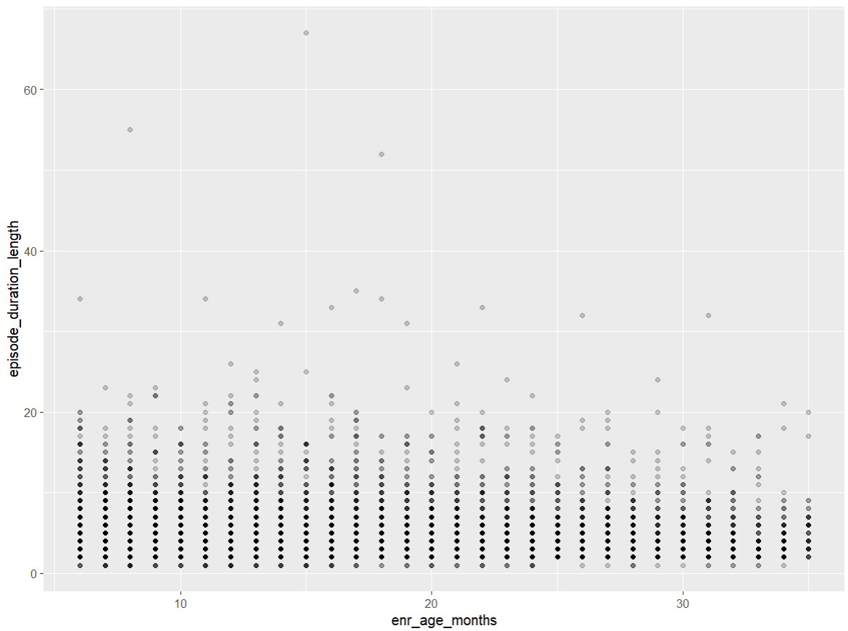
Example 1: producing plots iteratively
produce_figure = function(site="all") {
if(site==“all") {
df = scrambled_data
} else {
df = scrambled_data %>% filter(enroll_site=={{site}})
}
ggplot(data = df,
aes(x=enr_age_months, y=episode_duration_length)) +
geom_point(alpha = 0.2, shape = 19)
}
produce_figure()
Notes:
Here is the plot produced when we run the function with no arguments. Note that the default argument is “all”, so this plot uses data from all sites.

Slide 37
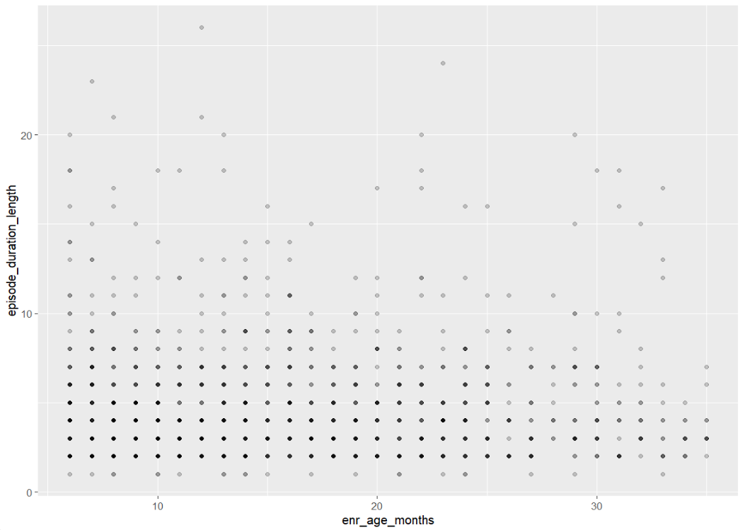
Example 1: producing plots iteratively
produce_figure = function(site="all") {
if(site==“all") {
df = scrambled_data
} else {
df = scrambled_data %>% filter(enroll_site=={{site}})
}
ggplot(data = df,
aes(x=enr_age_months, y=episode_duration_length)) +
geom_point(alpha = 0.2, shape = 19)
}
produce_figure(“Bangladesh”)
Notes:
Next we can look at the plots produced for Bangladesh

Slide 38
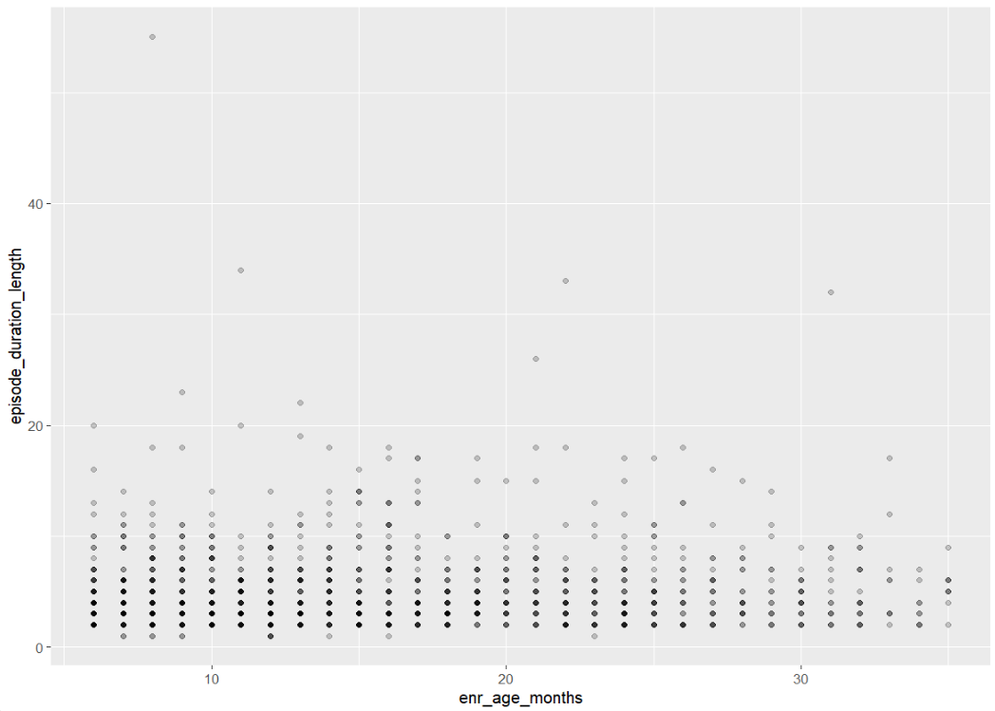
Example 1: producing plots iteratively
produce_figure = function(site="all") {
if(site==“all") {
df = scrambled_data
} else {
df = scrambled_data %>% filter(enroll_site=={{site}})
}
ggplot(data = df,
aes(x=enr_age_months, y=episode_duration_length)) +
geom_point(alpha = 0.2, shape = 19)
}
produce_figure(site=“Mali”)
Notes:
…and Mali

Slide 39
Example 2: running a function through nested for-loops
Purpose
Assess how well four different measures of diarrhea severity predict hospitalization after the diarrhea episode
Details
Calculate five measures of diagnostic accuracy (sensitivity, specificity, diagnostic accuracy, positive predictive value, negative predictive value)
Among combinations of 2 sub-groups
Pathogen (all diarrhea vs. Shigella)
Treatment (overall, any antibiotics, and none)
Notes:
For this next example, we are interested in how well four measures of diarrhea severity predict hospitalization. We going to calculate a series of measures of diagnostic accuracy overall and among a combination of two sub-groups: by pathogen and by antibiotic treatment.

Slide 40
Example 2: running a function through nested for-loops
calculate_diagnostic_accuracy = function(d, severity_definition, denominator, antibiotics) {
two_by_two = d %>%
group_by(!!!syms(severity_definition), hosp_factor) %>%
summarise(n = n(), .groups = "keep")
test = epi.tests(two_by_two, method = "exact", digits = 2, conf.level = 0.95)
result = test$detail |>
filter(statistic=="se" | statistic=="sp" | statistic=="pv.pos" | statistic=="pv.neg" | statistic=="diag.ac") |>
select(statistic, est) |>
rename(value = est, measure = statistic) |>
mutate(value = value*100) |>
mutate(severity_definition = {{severity_definition}},
denom = {{denominator}},
antibiotics = {{antibiotics}})
return(result)
}
Notes:
Here is the function. There is a lot going on here, so let’s break it down.

Slide 41
Example 2: running a function through nested for-loops
calculate_diagnostic_accuracy = function(d, severity_definition, denominator, antibiotics) {
two_by_two = d %>%
group_by(!!!syms(severity_definition), hosp_factor) %>%
summarise(n = n(), .groups = "keep")
test = epi.tests(two_by_two, method = "exact", digits = 2, conf.level = 0.95)
result = test$detail |>
filter(statistic=="se" | statistic=="sp" | statistic=="pv.pos" | statistic=="pv.neg" | statistic=="diag.ac") |>
select(statistic, est) |>
rename(value = est, measure = statistic) |>
mutate(value = value*100) |>
mutate(severity_definition = {{severity_definition}},
denom = {{denominator}},
antibiotics = {{antibiotics}})
return(result)
}
Input data
Notes:
First we specify the input data as “d”. This is the first function argument

Slide 42
Example 2: running a function through nested for-loops
calculate_diagnostic_accuracy = function(d, severity_definition, denominator, antibiotics) {
two_by_two = d %>%
group_by(!!!syms(severity_definition), hosp_factor) %>%
summarise(n = n(), .groups = "keep")
test = epi.tests(two_by_two, method = "exact", digits = 2, conf.level = 0.95)
result = test$detail |>
filter(statistic=="se" | statistic=="sp" | statistic=="pv.pos" | statistic=="pv.neg" | statistic=="diag.ac") |>
select(statistic, est) |>
rename(value = est, measure = statistic) |>
mutate(value = value*100) |>
mutate(severity_definition = {{severity_definition}},
denom = {{denominator}},
antibiotics = {{antibiotics}})
return(result)
}
Calculates measures of interest
Notes:
The first part of the function calculates the measures of interest
So in this case, we create a two by two table and then use the R function epi.tests to calculate sensitivity, specificity, diagnostic accuracy, positive predictive value, and negative predictive value

Slide 43
Example 2: running a function through nested for-loops
calculate_diagnostic_accuracy = function(d, severity_definition, denominator, antibiotics) {
two_by_two = d %>%
group_by(!!!syms(severity_definition), hosp_factor) %>%
summarise(n = n(), .groups = "keep")
test = epi.tests(two_by_two, method = "exact", digits = 2, conf.level = 0.95)
result = test$detail |>
filter(statistic=="se" | statistic=="sp" | statistic=="pv.pos" | statistic=="pv.neg" | statistic=="diag.ac") |>
select(statistic, est) |>
rename(value = est, measure = statistic) |>
mutate(value = value*100) |>
mutate(severity_definition = {{severity_definition}},
denom = {{denominator}},
antibiotics = {{antibiotics}})
return(result)
}
Formatting results
Notes:
In the second part of the function, we format the results to just pull out those five measures and put them in one column.

Slide 44
Example 2: running a function through nested for-loops
calculate_diagnostic_accuracy = function(d, severity_definition, denominator, antibiotics) {
two_by_two = d %>%
group_by(!!!syms(severity_definition), hosp_factor) %>%
summarise(n = n(), .groups = "keep")
test = epi.tests(two_by_two, method = "exact", digits = 2, conf.level = 0.95)
result = test$detail |>
filter(statistic=="se" | statistic=="sp" | statistic=="pv.pos" | statistic=="pv.neg" | statistic=="diag.ac") |>
select(statistic, est) |>
rename(value = est, measure = statistic) |>
mutate(value = value*100) |>
mutate(severity_definition = {{severity_definition}},
denom = {{denominator}},
antibiotics = {{antibiotics}})
return(result)
}
Other arguments for labelling output
Notes:
In the second part of the function we also add three columns that describe the severity definition of interest, the denominator, and the antibiotics grouping. This way, when we generate many results at once, we can keep track of what results belong to which groups.
Note that severity_definition, denominator, and antibiotics are the second, third, and fourth arguments in the function.

Slide 45
Example 2: running a function through nested for-loops
calculate_diagnostic_accuracy = function(d, severity_definition, denominator, antibiotics) {
two_by_two = d %>%
group_by(!!!syms(severity_definition), hosp_factor) %>%
summarise(n = n(), .groups = "keep")
test = epi.tests(two_by_two, method = "exact", digits = 2, conf.level = 0.95)
result = test$detail |>
filter(statistic=="se" | statistic=="sp" | statistic=="pv.pos" | statistic=="pv.neg" | statistic=="diag.ac") |>
select(statistic, est) |>
rename(value = est, measure = statistic) |>
mutate(value = value*100) |>
mutate(severity_definition = {{severity_definition}},
denom = {{denominator}},
antibiotics = {{antibiotics}})
return(result)
}
Notes:
Notice that in two places within this function, we are passing along the name of an argument to be manipulated as a variable within the function. Like in the previous example, in order for R to understand the argument as a string, not an argument within the function, we need to signal that we are “pasting” in the value of the argument

Slide 46
Example 2: running a function through nested for-loops
calculate_diagnostic_accuracy = function(d, severity_definition, denominator, antibiotics) {
two_by_two = d %>%
group_by(!!!syms(severity_definition), hosp_factor) %>%
summarise(n = n(), .groups = "keep")
test = epi.tests(two_by_two, method = "exact", digits = 2, conf.level = 0.95)
result = test$detail |>
filter(statistic=="se" | statistic=="sp" | statistic=="pv.pos" | statistic=="pv.neg" | statistic=="diag.ac") |>
select(statistic, est) |>
rename(value = est, measure = statistic) |>
mutate(value = value*100) |>
mutate(severity_definition = {{severity_definition}},
denom = {{denominator}},
antibiotics = {{antibiotics}})
return(result)
}
Other tricks for calling variables passed along as function arguments:
tidyverse glue syntax (recommended)
{a}
{{a}}
“{a}”
Deprecated but sometimes work
!!sym(a)
UQ(sym(a))
eval(substitute(a))
.data[[a]]
Use the walrus operator (:=) instead of the equals sign (=) within dyplr verbs such as mutate
Notes:
As an aside, there are many ways to do this. The glue syntax using curly brackets is recommended when using tidyverse piping and verbs, but I’ve found that it doesn’t always work. Here are some alternatives I’ve found to work previously, assuming the passed along variable is called “a”

Slide 47
Example 2: running a function through nested for-loops
calculate_diagnostic_accuracy(d = scrambled_data,
severity_definition = “mvs_factor”,
denominator = “all diarrhea”,
antibiotics = “overall”)
calculate_diagnostic_accuracy = function(d, severity_definition, denominator, antibiotics) {
two_by_two = d %>%
group_by(!!!syms(severity_definition), hosp_factor) %>%
summarise(n = n(), .groups = "keep")
test = epi.tests(two_by_two, method = "exact", digits = 2, conf.level = 0.95)
result = test$detail |>
filter(statistic=="se" | statistic=="sp" | statistic=="pv.pos" | statistic=="pv.neg" | statistic=="diag.ac") |>
select(statistic, est) |>
rename(value = est, measure = statistic) |>
mutate(value = value*100) |>
mutate(severity_definition = {{severity_definition}},
denom = {{denominator}},
antibiotics = {{antibiotics}})
return(result)
}
measure value severity_definition denom antibiotics
se 77.1 mvs_factor all diarrhea overall
sp 3.5 mvs_factor all diarrhea overall
diag.ac 59.2 mvs_factor all diarrhea overall
pv.pos 71.3 mvs_factor all diarrhea overall
pv.neg 4.7 mvs_factor all diarrhea overall
Notes:
Now let’s text the function using a set of input arguments to see if it works. Our input arguments are
d = scrambled_data
severity_definition = “mvs_factor”
denominator = “all diarrhea”
antibiotics = “overall”
It works! We get a dataframe with our five measurements of interest, and three additional columns specifying the severity definition, denominator, and antibiotics

Slide 48
Example 2: running a function through nested for-loops
calculate_diagnostic_accuracy(d = scrambled_data,
severity_definition = “mvs_factor”,
denominator = “all diarrhea”,
antibiotics = “overall”)
calculate_diagnostic_accuracy = function(d, severity_definition, denominator, antibiotics) {
two_by_two = d %>%
group_by(!!!syms(severity_definition), hosp_factor) %>%
summarise(n = n(), .groups = "keep")
test = epi.tests(two_by_two, method = "exact", digits = 2, conf.level = 0.95)
result = test$detail |>
filter(statistic=="se" | statistic=="sp" | statistic=="pv.pos" | statistic=="pv.neg" | statistic=="diag.ac") |>
select(statistic, est) |>
rename(value = est, measure = statistic) |>
mutate(value = value*100) |>
mutate(severity_definition = {{severity_definition}},
denom = {{denominator}},
antibiotics = {{antibiotics}})
return(result)
}
measure value severity_definition denom antibiotics
se 77.1 mvs_factor all diarrhea overall
sp 3.5 mvs_factor all diarrhea overall
diag.ac 59.2 mvs_factor all diarrhea overall
pv.pos 71.3 mvs_factor all diarrhea overall
pv.neg 4.7 mvs_factor all diarrhea overall
Notes:
Notice that when we specified arguments, the first argument scrambled_data did not have quotation marks because we are referencing an object (a dataframe) in the global environment. However, the other three arguments are strings, and therefore we have to put them in quotes.

Slide 49
Example 2: running a function through nested for-loops
definitions_severity = c(“mvs_factor”, “mvs_or_dysentery_factor”,
“clark_factor”, “gems_msd_factor”)
denom = c(“all diarrhea”, “shigella”)
antibiotics = c(“overall”, “antibiotics”, “no antibiotics”)
diagnostic_accuracy = data.frame()
Notes:
Now we’ll set up objects to use in nested for-loops. Here, we create three vectors, each with all our severity definitions, pathogen groups, and antibiotic groups of interest. We’ll also specify an empty dataframe “diagnostic_accuracy” to store our results

Slide 50
Example 2: running a function through nested for-loops
for(i in definitions_severity) {
for(j in denom) {
for(k in antibiotics) {
if (j==“all diarrhea”) { d = scrambled_data
} else if (j==“shigella”) { d = scrambled_data |> filter(positive_tac_or_culture==1)
} else (“Error: incorrect denominator argument)
if (k==“overall”) { d = d
} else if (k==“antibiotics”) { d = d |> filter(any_abx==1)
} else if (k==“no antibiotics”) { d = d |> filter(any_abx==0)
} else (“Error: incorrect antibiotics argument)
diagnostic_accuracy = rbind(diagnostic accuracy, calculate_diagnostic_accuracy(d, i, j, k))
}
}
}
Notes:
Now, we’ll run the function through three levels of nested for-loops

Slide 51
Example 2: running a function through nested for-loops
for(i in definitions_severity) {
for(j in denom) {
for(k in antibiotics) {
if (j==“all diarrhea”) { d = scrambled_data
} else if (j==“shigella”) { d = scrambled_data |> filter(positive_tac_or_culture==1)
} else (“Error: incorrect denominator argument)
if (k==“overall”) { d = d
} else if (k==“antibiotics”) { d = d |> filter(any_abx==1)
} else if (k==“no antibiotics”) { d = d |> filter(any_abx==0)
} else (“Error: incorrect antibiotics argument)
diagnostic_accuracy = rbind(diagnostic accuracy, calculate_diagnostic_accuracy(d, i, j, k))
}
}
}
Outermost for-loop: severity definitions
Notes:
First let’s look at the three levels of for-loops. The outermost for-loop runs the function through the four severity definitions described in the vector definitions_severity. We label the severity definitions “i” within the for-loop and pass this along to the function we specified (calculate_diagnostic_accuracy) as the second argument

Slide 52
Example 2: running a function through nested for-loops
for(i in definitions_severity) {
for(j in denom) {
for(k in antibiotics) {
if (j==“all diarrhea”) { d = scrambled_data
} else if (j==“shigella”) { d = scrambled_data |> filter(positive_tac_or_culture==1)
} else (“Error: incorrect denominator argument)
if (k==“overall”) { d = d
} else if (k==“antibiotics”) { d = d |> filter(any_abx==1)
} else if (k==“no antibiotics”) { d = d |> filter(any_abx==0)
} else (“Error: incorrect antibiotics argument)
diagnostic_accuracy = rbind(diagnostic accuracy, calculate_diagnostic_accuracy(d, i, j, k))
}
}
}
Middle for-loop: denominator
Notes:
The middle for-loop represents the denominator or pathogen and we call this j. Similarly to the severity definitions, we pass this along to the third argument of the function we defined earlier

Slide 53
Example 2: running a function through nested for-loops
for(i in definitions_severity) {
for(j in denom) {
for(k in antibiotics) {
if (j==“all diarrhea”) { d = scrambled_data
} else if (j==“shigella”) { d = scrambled_data |> filter(positive_tac_or_culture==1)
} else (“Error: incorrect denominator argument)
if (k==“overall”) { d = d
} else if (k==“antibiotics”) { d = d |> filter(any_abx==1)
} else if (k==“no antibiotics”) { d = d |> filter(any_abx==0)
} else (“Error: incorrect antibiotics argument)
diagnostic_accuracy = rbind(diagnostic accuracy, calculate_diagnostic_accuracy(d, i, j, k))
}
}
}
Middle for-loop: denominator
Notes:
But with the middle for loop we also do something different. Here, we want to specify whether we are calculating the statistical measures for all children with diarrhea, or just among those with Shigella. So we add some if-else statements here to define d, the data that is then also passed along to the function.

Slide 54
Example 2: running a function through nested for-loops
for(i in definitions_severity) {
for(j in denom) {
for(k in antibiotics) {
if (j==“all diarrhea”) { d = scrambled_data
} else if (j==“shigella”) { d = scrambled_data |> filter(positive_tac_or_culture==1)
} else (“Error: incorrect denominator argument)
if (k==“overall”) { d = d
} else if (k==“antibiotics”) { d = d |> filter(any_abx==1)
} else if (k==“no antibiotics”) { d = d |> filter(any_abx==0)
} else (“Error: incorrect antibiotics argument)
diagnostic_accuracy = rbind(diagnostic accuracy, calculate_diagnostic_accuracy(d, i, j, k))
}
}
}
Inner for-loop: antibiotic treatment
Notes:
Finally, the inner for-loop defines groups by whether or not they received antibiotic treatment, and we call this variable k and pass it along to the fourth argument in the function.

Slide 55
Example 2: running a function through nested for-loops
for(i in definitions_severity) {
for(j in denom) {
for(k in antibiotics) {
if (j==“all diarrhea”) { d = scrambled_data
} else if (j==“shigella”) { d = scrambled_data |> filter(positive_tac_or_culture==1)
} else (“Error: incorrect denominator argument)
if (k==“overall”) { d = d
} else if (k==“antibiotics”) { d = d |> filter(any_abx==1)
} else if (k==“no antibiotics”) { d = d |> filter(any_abx==0)
} else (“Error: incorrect antibiotics argument)
diagnostic_accuracy = rbind(diagnostic accuracy, calculate_diagnostic_accuracy(d, i, j, k))
}
}
}
Inner for-loop: antibiotic treatment
Notes:
As with the denominator, we have to specify the data we would like calculated by refining the object d and then passing this along to the function.

Slide 56
Example 2: running a function through nested for-loops
for(i in definitions_severity) {
for(j in denom) {
for(k in antibiotics) {
if (j==“all diarrhea”) { d = scrambled_data
} else if (j==“shigella”) { d = scrambled_data |> filter(positive_tac_or_culture==1)
} else (“Error: incorrect denominator argument)
if (k==“overall”) { d = d
} else if (k==“antibiotics”) { d = d |> filter(any_abx==1)
} else if (k==“no antibiotics”) { d = d |> filter(any_abx==0)
} else (“Error: incorrect antibiotics argument)
diagnostic_accuracy = rbind(diagnostic accuracy, calculate_diagnostic_accuracy(d, i, j, k))
}
}
}
Inner for-loop: antibiotic treatment
Notes:
as with the denominator, we have to specify the data we would like calculated by refining the object d and then passing this along to the function

Slide 57
Example 2: running a function through nested for-loops
for(i in definitions_severity) {
for(j in denom) {
for(k in antibiotics) {
if (j==“all diarrhea”) { d = scrambled_data
} else if (j==“shigella”) { d = scrambled_data |> filter(positive_tac_or_culture==1)
} else (“Error: incorrect denominator argument)
if (k==“overall”) { d = d
} else if (k==“antibiotics”) { d = d |> filter(any_abx==1)
} else if (k==“no antibiotics”) { d = d |> filter(any_abx==0)
} else (“Error: incorrect antibiotics argument)
diagnostic_accuracy = rbind(diagnostic accuracy, calculate_diagnostic_accuracy(d, i, j, k))
}
}
}
Notes:
So to summarize, we use this loop to define the data input “d” by two levels: whether all children with diarrhea or just those with shigella will be included, and then whether we will include those treated with antibiotics, those not treated with antibiotics, or all. This data “d” is passed to the function and is the data used to run the calculations. The other 3 arguments passed to the function, i, j, and k, are used to label the corresponding output so that we can organize our results. The results will all be stored in the currently empty data frame “diagnostic_accuracy”

Slide 58
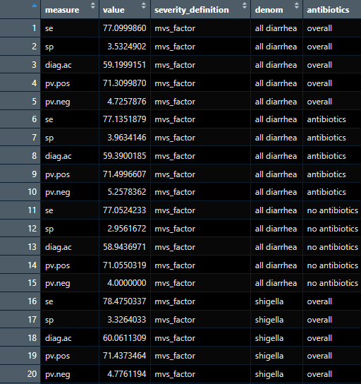
Example 2: running a function through nested for-loops
Notes:
This is what the output looks like!

Slide 59

map

Slide 60
structure
map(.x, .f)
map_df(.x, .f)
map_dbl(.x, .f)
map_chr(.x, .f)
map_lgl(.x, .f)
2 inputs: data (.x) and function (.f)
Because data is the first argument of all map functions, it works well with piping syntax
Above functions return different types of objects, in order: list, dataframe, double (numeric) vector, character vector, logical vector

Slide 61
map with vectors
map_chr(c(“Red”, “Green”, “Yellow”), ~ paste0(.x, “ apple”)
[1] “Red apple” “Green apple” “Yellow apple”
map_chr(c(“Dogs are excellent”, “Cats are excellent”), \(value) str_replace(value, “excellent”, “great”)
[1] “Dogs are great” “Cats are great”
c(4, 19, 8) |> map_dbl(~ . + 5)
[1] 9 24 13
Notes:
The first example pastes “ apple” to each item in a character vector.
The second example replaces the word “excellent” with “great” for each item in a character vector.
The third example adds 5 to each item in a double (numeric) vector

Slide 62
map with vectors
map_chr(c(“Red”, “Green”, “Yellow”), ~ paste0(.x, “ apple”)
[1] “Red apple” “Green apple” “Yellow apple”
map_chr(c(“Dogs are excellent”, “Cats are excellent”), \(value) str_replace(value, “excellent”, “great”)
[1] “Dogs are great” “Cats are great”
c(4, 19, 8) |> map_dbl(~ . + 5)
[1] 9 24 13
Map function
Notes:
Notice there are different map functions for character and double (numeric) vectors

Slide 63
map with vectors
map_chr(c(“Red”, “Green”, “Yellow”), ~ paste0(.x, “ apple”)
[1] “Red apple” “Green apple” “Yellow apple”
map_chr(c(“Dogs are excellent”, “Cats are excellent”), \(value) str_replace(value, “excellent”, “great”)
[1] “Dogs are great” “Cats are great”
c(4, 19, 8) |> map_dbl(~ . + 5)
[1] 9 24 13
Input data
Notes:
in the first two examples, the input data is defined within the map function. in the third example, the data is defined previously and the map function is piped in afterwards. notice that the data is not re-specified within the map function; it is understood that the data piped in is the first argument

Slide 64
map with vectors
map_chr(c(“Red”, “Green”, “Yellow”), ~ paste0(.x, “ apple”)
[1] “Red apple” “Green apple” “Yellow apple”
map_chr(c(“Dogs are excellent”, “Cats are excellent”), \(value) str_replace(value, “excellent”, “great”)
[1] “Dogs are great” “Cats are great”
c(4, 19, 8) |> map_dbl(~ . + 5)
[1] 9 24 13
User-specified function
Notes:
note that there are several approaches to defining functions within the map function. Here, we are using a technique called “anonymous functions” and the formula symbol

Slide 65
map with vectors
new_function = function(x) {x * 2}
new_function(2)
4
map_chr(c(“Red”, “Green”, “Yellow”), ~ paste0(.x, “ apple”)
[1] “Red apple” “Green apple” “Yellow apple”
map_chr(c(“Dogs are excellent”, “Cats are excellent”), \(value) str_replace(value, “excellent”, “great”)
[1] “Dogs are great” “Cats are great”
c(4, 19, 8) |> map_dbl(~ . + 5)
[1] 9 24 13
User-specified function
Notes:
typical functions in R are named using the syntax function(x) and curly brackets. but this is not concise, and we may not need to give all functions a name (especially those occurring within functions like map where we may just be manipulating data)

Slide 66
map with vectors
map_chr(c(“Red”, “Green”, “Yellow”), ~ paste0(.x, “ apple”)
[1] “Red apple” “Green apple” “Yellow apple”
map_chr(c(“Dogs are excellent”, “Cats are excellent”), \(value) str_replace(value, “excellent”, “great”)
[1] “Dogs are great” “Cats are great”
c(4, 19, 8) |> map_dbl(~ . + 5)
[1] 9 24 13
User-specified function
Notes:
instead, we can use the formula symbol which is a tilde. map will automatically understand .x or . to be the function input; you can use either interchangeably.
another alternative is to use an anonymous function, where instead of writing out function(x) we can use a backwards slash. in the second example, I’ve defined the function input as “value”, but you could use any string here (for example, x, df)

Slide 67
map with dataframes
data.frame(a = c(1, 2, 3), b = c(2, 5, 4), c = c(3, 2, 5)) |> map_df(~ .x + 5)
a b c
[1] 6 7 8
[2] 7 10 7
[3] 8 9 10
Notes:
in this example, the function is applied to the entire dataframe using map_df

Slide 68
map with dataframes
data.frame(a = c(1, 99, 3), b = c(2, 5, 4), c = c(99, 2, 5)) |> map_df(~ ifelse(.x==99, NA, .x))
a b c
[1] 6 7 NA
[2] NA 10 7
[3] 8 9 10
Notes:
we can use this for more complex functions – for example, let’s replace all values of 99 in a dataframe with NA

Slide 69
example 1: filter all datasets to the same date range
data_date = as.Date(“2024-01-01”)
included_pids = scrambled_data$pid[scrambled_data$enroll_date<data_date]
Notes:
in this example, we would like to generate a report using data collected through a certain date
this is to avoid reporting on data that hasn't been queried yet
our goal is to reproduce each dataset so that it only contains data from the desired date range
first, we will make a vector of all the pids that were enrolled prior to the date of interest (January 1, 2024)
note that these datasets all include data collected at enrollment, so when filtering by date we can just specify the date of enrollment. for longitudinal data (i.e., if we had forms taken at follow-up), we may need to create a pid list for each point in time.

Slide 70
example 1: filter all datasets to the same date range
dataframes = list(scrambled_data = scrambled_data,
scrambled_preenrollment = scrambled_preenrollment)
report_date_data = dataframes |>
map(\(df) df |> filter(pid %in% included_pids)
list2env(report_date_data, envir = .GlobalEnv)
List with dataframes
Notes:
next, we will create a list of all the dataframes of interest, where we assign each dataframe in the list the same name of the original dataframe. for now, we will just use the dataframes that have a pid column.

Slide 71
example 1: filter all datasets to the same date range
dataframes = list(scrambled_data = scrambled_data,
scrambled_preenrollment = scrambled_preenrollment)
report_date_data = dataframes |>
map(\(df) df |> filter(pid %in% included_pids)
list2env(report_date_data, envir = .GlobalEnv)
Map function
Notes:
We use the map function to filter out just the observations in the pid list we made earlier for all dataframes in the “dataframes” list

Slide 72
example 1: filter all datasets to the same date range
dataframes = list(scrambled_data = scrambled_data,
scrambled_preenrollment = scrambled_preenrollment)
report_date_data = dataframes |>
map(\(df) df |> filter(pid %in% included_pids)
list2env(report_date_data, envir = .GlobalEnv)
Export dataframes to global environment
Notes:
However, these dataframes are still stored in a list format because we used map, not map_df. To write them back as dataframes that can be manipulated in the global environment, we use the function list2env()

Slide 73
example 2: fix inconsistencies across datasets for merging
rbind(scrambled_prescreening, scrambled_screening)
Error in rbind(deparse.level, …) : numbers of columns of arguments do not match
rbind(scrambled_prescreening, scrambled_screening |> select(-scr_diar_when)
serial_id date eligible
<chr> <chr> <chr>
181211173 2022-07-04 12:54 1
520791573 2022-07-05 09:58 1
816673173 2022-07-05 10:22 0
Notes:
In this second example, we would like to combine the rows of three datasets (scrambled_prescreening, scrambled_screening, scrambled_preenrollment). We will do this by stacking the dataframes on top of each other using rbind. In order to do so, we need to make sure the corresponding columns in each of the datasets align
When we try to simply use the command rbind, we run into issues – there are a different number of columns., When we fix that by removing the extra column we still have an issue. the columns are all in character format, when we want serial_id and eligible to be numeric and date to be date.

Slide 74

example 2: fix inconsistencies across datasets for merging
rbind(scrambled_prescreening, scrambled_screening)
Error in rbind(deparse.level, …) : numbers of columns of arguments do not match
rbind(scrambled_prescreening, scrambled_screening |> select(-scr_diar_when)
serial_id date eligible
<chr> <chr> <chr>
181211173 2022-07-04 12:54 1
520791573 2022-07-05 09:58 1
816673173 2022-07-05 10:22 0
Notes:
map can make this process more efficient!

Slide 75
example 2: fix inconsistencies across datasets for merging
screening_list = list(scrambled_prescreening = scrambled_prescreening, scrambled_screening = scrambled_ screening,
scrambled_preenrollment = scrambled_preenrollment)
Notes:
First we’ll make a list containing the dataframes of interest

Slide 76
example 2: fix inconsistencies across datasets for merging
screening_list = list(scrambled_prescreening = scrambled_prescreening, scrambled_screening = scrambled_ screening,
scrambled_preenrollment = scrambled_preenrollment)
combined_screening_forms = screening_list |>
map(\(df) df |> mutate(across(everything(), ~ ifelse(.x=="", NA, .x)))) |>
map(\(df) df |> mutate(across(c(serial_id, eligible), ~ as.numeric(.x)))) |>
map(\(df) df |> mutate(across(c(date), ~ as.Date(.x)))) |>
map(\(df) df |> select(any_of(c("serial_id", "date", "eligible")))) |>
list_rbind(names_to = "form") |>
mutate(form = str_replace(form, "scrambled_", ""))
Using map to harmonize data
Notes:
Next, we will use a series of map functions to clean the data within all dataframes before combining it together

Slide 77
example 2: fix inconsistencies across datasets for merging
screening_list = list(scrambled_prescreening = scrambled_prescreening, scrambled_screening = scrambled_ screening,
scrambled_preenrollment = scrambled_preenrollment)
combined_screening_forms = screening_list |>
map(\(df) df |> mutate(across(everything(), ~ ifelse(.x=="", NA, .x)))) |>
map(\(df) df |> mutate(across(c(serial_id, eligible), ~ as.numeric(.x)))) |>
map(\(df) df |> mutate(across(c(date), ~ as.Date(.x)))) |>
map(\(df) df |> select(any_of(c("serial_id", "date", "eligible")))) |>
list_rbind(names_to = "form") |>
mutate(form = str_replace(form, "scrambled_", ""))
Notes:
The first row replaces blank cells with NA values, which are easier to manipulate in R. The across(everything()) function ensures this is applied to all columns in all dataframes

Slide 78
example 2: fix inconsistencies across datasets for merging
screening_list = list(scrambled_prescreening = scrambled_prescreening, scrambled_screening = scrambled_ screening,
scrambled_preenrollment = scrambled_preenrollment)
combined_screening_forms = screening_list |>
map(\(df) df |> mutate(across(everything(), ~ ifelse(.x=="", NA, .x)))) |>
map(\(df) df |> mutate(across(c(serial_id, eligible), ~ as.numeric(.x)))) |>
map(\(df) df |> mutate(across(c(date), ~ as.Date(.x)))) |>
map(\(df) df |> select(any_of(c("serial_id", "date", "eligible")))) |>
list_rbind(names_to = "form") |>
mutate(form = str_replace(form, "scrambled_", ""))
Notes:
The second and third row specify that serial_id and eligible should be transformed to numeric columns and date should be a date column

Slide 79
example 2: fix inconsistencies across datasets for merging
screening_list = list(scrambled_prescreening = scrambled_prescreening, scrambled_screening = scrambled_ screening,
scrambled_preenrollment = scrambled_preenrollment)
combined_screening_forms = screening_list |>
map(\(df) df |> mutate(across(everything(), ~ ifelse(.x=="", NA, .x)))) |>
map(\(df) df |> mutate(across(c(serial_id, eligible), ~ as.numeric(.x)))) |>
map(\(df) df |> mutate(across(c(date), ~ as.Date(.x)))) |>
map(\(df) df |> select(any_of(c("serial_id", "date", "eligible")))) |>
list_rbind(names_to = "form") |>
mutate(form = str_replace(form, "scrambled_", ""))
Notes:
The fourth row selects only the three columns that will be merged from each dataset

Slide 80
example 2: fix inconsistencies across datasets for merging
screening_list = list(scrambled_prescreening = scrambled_prescreening, scrambled_screening = scrambled_ screening,
scrambled_preenrollment = scrambled_preenrollment)
combined_screening_forms = screening_list |>
map(\(df) df |> mutate(across(everything(), ~ ifelse(.x=="", NA, .x)))) |>
map(\(df) df |> mutate(across(c(serial_id, eligible), ~ as.numeric(.x)))) |>
map(\(df) df |> mutate(across(c(date), ~ as.Date(.x)))) |>
map(\(df) df |> select(any_of(c("serial_id", "date", "eligible")))) |>
list_rbind(names_to = "form") |>
mutate(form = str_replace(form, "scrambled_", ""))
Combine dataframes
Notes:
Finally, we feed this list to the list_rbind() function which combines all the dataframes in the list into a single dataframe. Note that we use the argument “names_to” to specify that the names of each of the objects in the list should be pasted into a new column called “form”, which on the last row we then manipulate to remove the prefix “scrambled_” from all values.

Slide 81

apply family

Slide 82
why a “family”?
There are many functions in the apply “family”
Most commonly used: apply, lapply, sapply, mapply
Which one you use depends on your input and output data structure
apply: input matrix/array; output matrix/array
lapply: input vector, dataframe or list; output list
sapply: input vector, dataframe or list; output vector, dataframe, or list
mapply: input multiple vectors, dataframes, or lists; output vector, dataframe, or list

Slide 83
structure
apply(X, MARGIN, FUN, …)
At least 3 inputs
X: input data (vector, dataframe, matrix, list, …)
MARGIN: defines how function is applied
MARGIN=1 -> function applied over rows
MARGIN=2 -> function applied over columns
FUN: function to be applied over data

Slide 84
Applying functions over rows and columns
Sum rows of a dataframe
rowsum <- apply(scrambled_data[c(“water_drink_level”, “sanitation_level”)], 1, sum)
rowsum
> [1] 2 2 2 2 2 2 2 2 2 2 2 2 2 2 2 2 2 5 2 2 2 2 3 3 2 2 2 2
Column means in a dataframe
colmean <- apply(scrambled_data[c(5, 7)], 2, mean)
colmean
> enroll_cg_age enr_age_months
26.7 15.7
Notes:
Let’s walk through two basic examples of using apply functions. In the first, we would like to take the sum across rows in our dataset. In the second, we would like to take the mean of columns in our dataset

Slide 85
Applying functions over rows and columns
Sum rows of a dataframe
rowsum <- apply(scrambled_data[c(“water_drink_level”, “sanitation_level”)], 1, sum)
rowsum
> [1] 2 2 2 2 2 2 2 2 2 2 2 2 2 2 2 2 2 5 2 2 2 2 3 3 2 2 2 2
Data
Column means in a dataframe
colmean <- apply(scrambled_data[c(5, 7)], 2, mean)
colmean
> enroll_cg_age enr_age_months
26.7 15.7
Notes:
The first argument specifies the data to be used. Note that in each of these examples, we specify a subset of columns. This is because not all columns in our dataset are numeric, so we would not be able to sum or average all of them.
For the first example, we are adding the scores for household water drinking and sanitation, where higher scores indicate lower level of water or sanitation service. In the second example, we are taking the average age of all caregivers and enrolled children in the study (in years and months, respectively)

Slide 86
Applying functions over rows and columns
Sum rows of a dataframe
rowsum <- apply(scrambled_data[c(“water_drink_level”, “sanitation_level”)], 1, sum)
rowsum
> [1] 2 2 2 2 2 2 2 2 2 2 2 2 2 2 2 2 2 5 2 2 2 2 3 3 2 2 2 2
Margin
(rows vs. columns)
Column means in a dataframe
colmean <- apply(scrambled_data[c(5, 7)], 2, mean)
colmean
> enroll_cg_age enr_age_months
26.7 15.7
Notes:
This second argument, the “margin”, specifies whether we are working across rows (1) or columns (2)

Slide 87
Applying functions over rows and columns
Sum rows of a dataframe
rowsum <- apply(scrambled_data[c(“water_drink_level”, “sanitation_level”)], 1, sum)
rowsum
> [1] 2 2 2 2 2 2 2 2 2 2 2 2 2 2 2 2 2 5 2 2 2 2 3 3 2 2 2 2
Function
Column means in a dataframe
colmean <- apply(scrambled_data[c(5, 7)], 2, mean)
colmean
> enroll_cg_age enr_age_months
26.7 15.7
Notes:
The third argument specifies the function we are applying to the dataframe. It is important to remember that the resulting object will be returned in the relevant dimension (i.e., number of rows for left example and number of columns for right example)

Slide 88
Example 1: matching values by row across subset of columns
scrambled_repeat_sex$sex_match <- ifelse(apply(df[c(2:5)],
1,
function(x) length(unique(na.omit(x)))) == 1, 1, 0)
scrambled_repeat_sex$sex_match
> [1] 1 1 1
Notes:
In this first example, we are looking at children who were enrolled multiple times in EFGH. As a data cleaning process, we examined these children to see if sex matched up across all enrollments

Slide 89
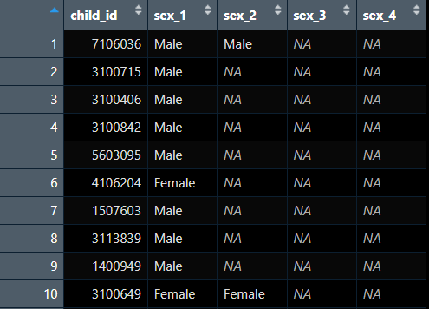
Example 1: matching values by row across subset of columns
scrambled_repeat_sex$sex_match <- ifelse(apply(df[c(2:5)],
1,
function(x) length(unique(na.omit(x)))) == 1, 1, 0)
scrambled_repeat_sex$sex_match
> [1] 1 1 1
Notes:
to do this, we created a new variable “sex_match” using ifelse() and apply(). The apply helped us examine whether all existing sex designations across several columns matched each other

Slide 90
Example 1: matching values by row across subset of columns
scrambled_repeat_sex$sex_match <- ifelse(apply(df[c(2:5)],
1,
function(x) length(unique(na.omit(x)))) == 1, 1, 0)
scrambled_repeat_sex$sex_match
> [1] 1 1 1
Can specify which columns function should be applied to
Notes:
We specified that we were interested in columns 2-5, which were the columns holding recorded sex for each enrollment

Slide 91
Example 1: matching values by row across subset of columns
scrambled_repeat_sex$sex_match <- ifelse(apply(df[c(2:5)],
1,
function(x) length(unique(na.omit(x)))) == 1, 1, 0)
scrambled_repeat_sex$sex_match
> [1] 1 1 1
Applied along rows
Notes:
MARGIN = 1 specified that we wanted the function to be applied across rows

Slide 92
Example 1: matching values by row across subset of columns
scrambled_repeat_sex$sex_match <- ifelse(apply(df[c(2:5)],
1,
function(x) length(unique(na.omit(x)))) == 1, 1, 0)
scrambled_repeat_sex$sex_match
> [1] 1 1 1
User-specified function
Notes:
We then specified a function to indicate whether all the sex values matched across a row, or whether there was a discrepancy. If the values all matched, then the new variable was given a value of 1. If the values did not match, the variables was assigned a value of 0.

Slide 93

Do I even need a loop or function?

Slide 94
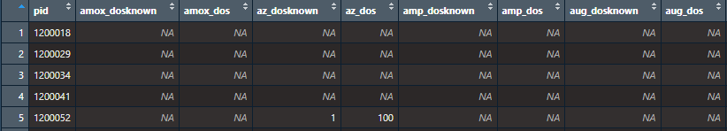
Sometimes…no
Example problem
Compare values from 2 columns by variable name
Impossible combination: if the dose is known, we shouldn’t see a dose of 99 (unknown)
Iterating through 20+ pairs of columns
Notes:
Impossible combination: if the dose for a medication is known (_dosknown), we shouldn’t see values of 99 (“don’t know”) in the second question (_dos)
This would be a lot of column pairs to check manually!

Slide 95
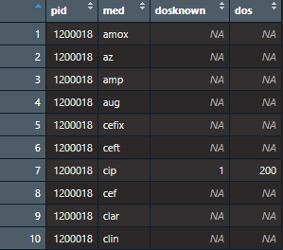
Alternative: Pivoting
long_medication <- scrambled_medication %>%
pivot_longer(!pid, names_to = c(“med”, “.value”), names_sep = “_”)
Notes:
We can pivot the dataframe into a long orientation so that the values from the two questions are on a separate line for each pid-medication combination

Slide 96
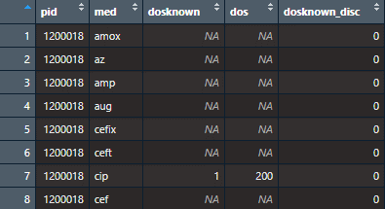
Alternative: Pivoting
long_medication <- scrambled_medication %>%
pivot_longer(!pid, names_to = c(“med”, “.value”), names_sep = “_”) %>%
mutate(dosknown_disc = ifelse(dosknown==1 & !is.na(dosknown) & is.na(dos), 1,
ifelse(dosknown==1 & !is.na(dosknown) & dos==99 & !is.na(dos), 1, 0)))
Notes:
Then we can compare the values directly with each pair on a separate row using mutate()

Slide 97
comparison
Type | Characteristics
For-loops | Somewhat intuitive syntax Requires understanding global vs. execution environments
Functions | Necessary to understand to use other forms of iteration Requires understanding local vs. global environments
Map family | Updated version of apply family Compatible with tidyverse syntax, verbs, and piping
Apply family | Can succinctly loop over cols/rows in dataframes Difficult syntax; steep learning curve

Slide 98

Summary & considerations
Multiple ways to approach any given problem
Global environment vs. execution environment within loop/function
Calling variable names within function & for loops may require specialized characters
Lists are your friend

Slide 99
references & resources
R for Data Science
See chapter 25 for functions and 26 for iteration
Advanced R
See chapter 7 for discussion on environments
Blog post on map functions

Slide 100
Thank you!!

